Slide 1
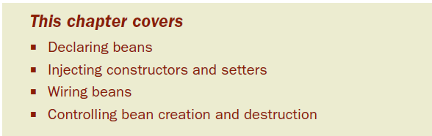
Chapter 2: Wiring beans
Any nontrivial application is made up of several objects that must work together to meet some business goal
Ex: online shopping application- an order manager component →a product manager component→a credit card authorization component
All →data access component to read from and write to a database.
Notes:
-Movie production example
-the actors, scriptwriters, directors, and producers—there are the not-so-obvious—the musicians, special effects crew, and art directors.
-If the director keeps to himself and doesn’t say “roll ’em,” then the cameraperson won’t start shooting.

Slide 2
But as we saw in chapter 1, the traditional approach to creating associations between application objects (via construction or lookup) leads to complicated code that’s difficult to reuse and unit test
Spring: objects aren’t responsible for finding or creating the other objects that they need to do their jobs, instead, they’re given references to the objects that they collaborate with by the container

Slide 3
An order manager component, for example, may need a credit card authorizer—but it doesn’t need to create the credit card authorizer. It just needs to show up empty-handed and it’ll be given a credit card authorizer to work with.
The act of creating these associations between application objects is the essence of dependency injection (DI) and is commonly referred to as wiring.
Notes:
-As DI is the most elemental thing Spring does, these are techniques you’ll use almost every time you develop Spring- based applications.

Slide 4

2.1 Declaring beans
The first (and likely the last) annual JavaBean talent competition - Spring Idol
In the Spring Idol talent competition, you’ll meet several contestants, all of which implement the Performer interface
Notes:
To get started, let’s set the stage for the competition by looking at the essentials of a Spring configuration.

Slide 5
2.1.1 Setting up Spring configuration
As has been said already, Spring is a container-based framework
We need to configure Spring to tell it what beans it should contain and how to wire those beans so that they can work together.
Spring 3.0: traditional XML and Java-based configuration option

Slide 6
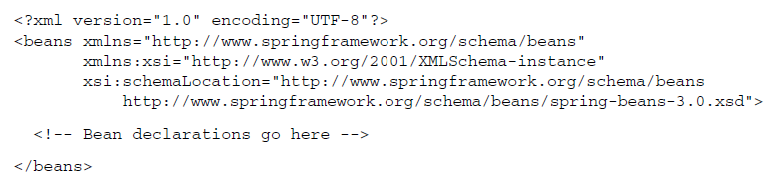
Within the <beans> you can place all of your Spring configuration, including <bean> declarations
But the beans namespace isn’t the only Spring namespace you’ll encounter
Notes:
-When declaring beans in XML, the root element of the Spring configuration file is the <beans> element from Spring’s beans schema.

Slide 7
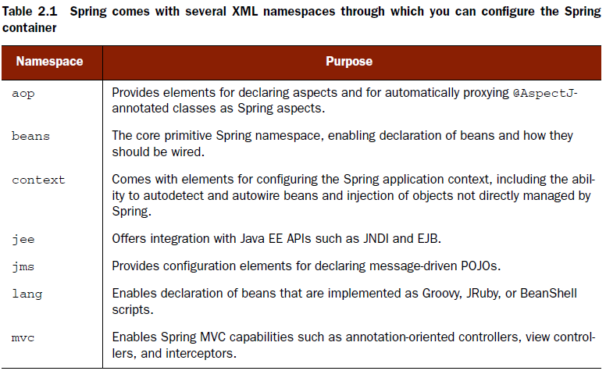
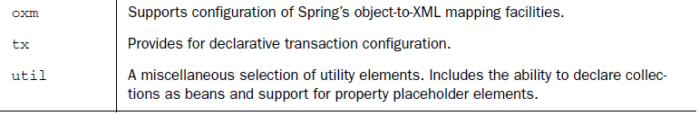
Notes:
We’ll see more of Spring’s namespaces as this book progresses. But for now, let’s fill in that conspicuously empty space in the middle of the XML configuration by adding some <bean> elements within <beans>.

Slide 8
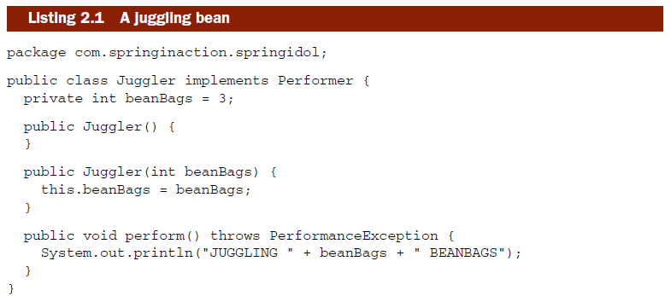
2.1.2 Declaring a simple bean
Spring Idol doesn’t cater to only singers
Notes:
-Unlike some similarly named talent competitions that you may have heard of, Spring Idol doesn’t cater to only singers. Many of the performers can’t carry a tune at all.

Slide 9

With the Juggler class defined, please welcome our first performer, Duke, to the stage.
The <bean> element is the most basic configuration unit in Spring.
Here you’ve declared Duke as a Spring-managed bean using what’s nearly the simplest <bean> declaration possible
The id attribute gives the bean a name by which it’ll be referred to in the Spring container
Notes:
-may verify spring-idol.xml

Slide 10
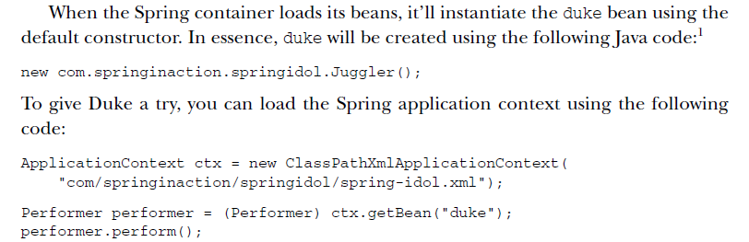
Exercise 2-1
Notes:
By default, Duke juggles only three beanbags at once. But juggling three beanbags isn’t all that impressive—anybody can do that. If Duke is to have any hope of winning the talent competition, he’s going to need to juggle many more beanbags at once. Let’s see how to configure Duke to be a champion juggler.
-Exercise 2-1: Declare duke as a bean by using springidol-context-2.xml. Create a class with main method: SpringIdolMain

Slide 11
2.1.3 Injecting through constructors
To really impress the judges, Duke has decided to break the world record by juggling as many as 15 beanbags at once.
Recall from listing 2.1 that the Juggler class can be constructed in two different ways:
Using the default constructor
Using a constructor that takes an int argument which indicates the number of beanbags that the Juggler will attempt to keep in the air
Notes:
Although the declaration of the duke bean in section 2.1.2 is valid, it uses the Juggler’s default constructor, which limits Duke to juggling only three beanbags at once. To make Duke a world-record juggler, we’ll need to use the other constructor

Slide 12
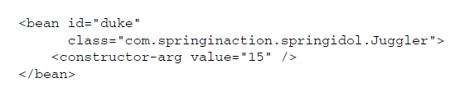
The <constructor-arg> element is used to give Spring additional information to use when constructing a bean.
Exercise 2-2
Back to Duke:
Not only is Duke a good juggler, but he’s also skilled at reciting poetry
Juggling while reciting a Shakespearean sonnet
Notes:
Exercise 2-2: Do constructor injection

Slide 13
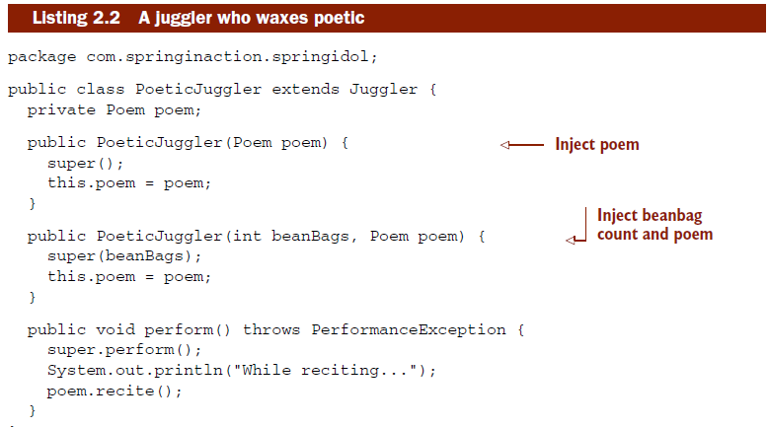
INJECTING OBJECT REFERENCES WITH CONSTRUCTORS
Because Duke is more than just an average juggler—he’s a poetic juggler—we need to define a new type of juggler for him to be.

Slide 14
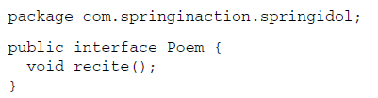
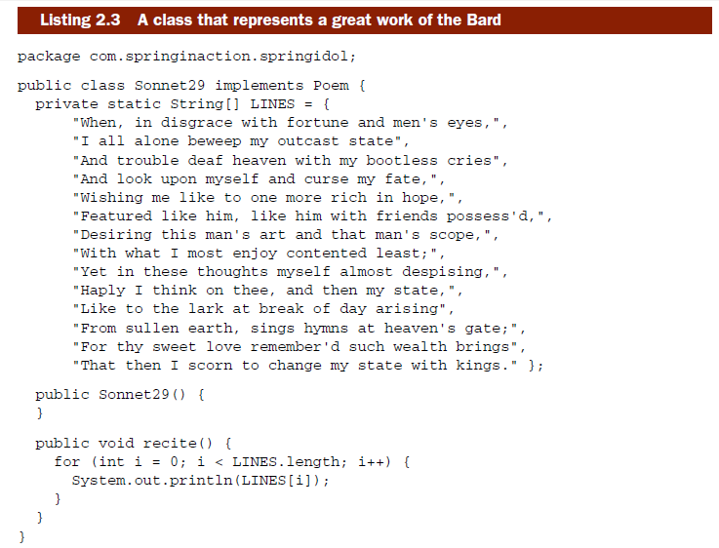

Slide 15
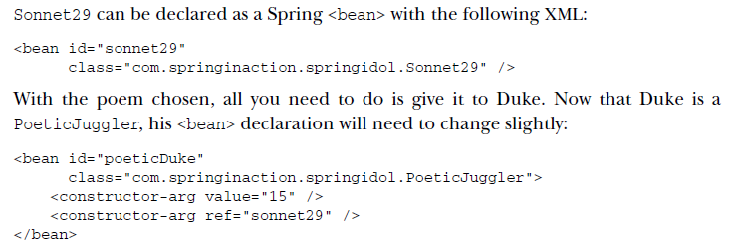
You can’t use value to set the second constructor argument because a Poem isn’t a simple type
Exercise 2-3
Creating beans through constructor injection is great, but what if the bean you want to declare doesn’t have a public constructor?
Notes:
-verify PoeticJuggler.java
-verify spring-idol.xml - poeticDukeBean

Slide 16
CREATING BEANS THROUGH FACTORY METHODS
Sometimes the only way to instantiate an object is through a static factory method.
Spring is ready-made to wire factory-created beans through the <bean> element’s factory-method attribute
Consider the case of configuring a singleton class as a bean in Spring

Slide 17
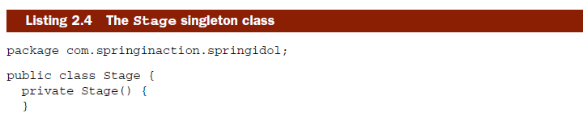
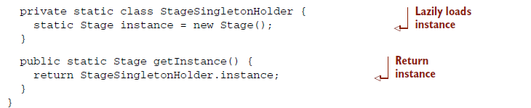
In the Spring Idol competition, we want to ensure that there’s only one stage for the performers to show their stuff. For thread safety, getInstance() employs a technique known as “initialization on demand holder” to create the singleton instance
Notes:
Singleton classes generally ensure that only one instance is created by only allowing creation through a static factory method.

Slide 18

How can we configure Stage as a bean in Spring without a public constructor?
Exercise 2-4
it’s perfectly suitable for any occasion where you need to wire an object produced by a static method
Notes:
Exercise 2-4:

Slide 19
2.1.4 Bean scoping
By default, all Spring beans are singletons
either through wiring or as the result of a call to the container’s getBean() method
But there may be times when you need a unique instance of a bean each time it’s asked for. How can you override Spring’s default singleton nature?

Slide 20

To force Spring to produce a new bean instance each time one is needed, you should declare the bean’s scope attribute to be prototype.
It’s important that everyone attending the performance be given a distinct ticket.
If the ticket bean were a singleton, what would happen?
Notes:
This would work out fine for the first person to arrive, but everyone else would be accused of ticket counterfeiting!
-Do ‘ticket’ singleton/prototype bean tests

Slide 21
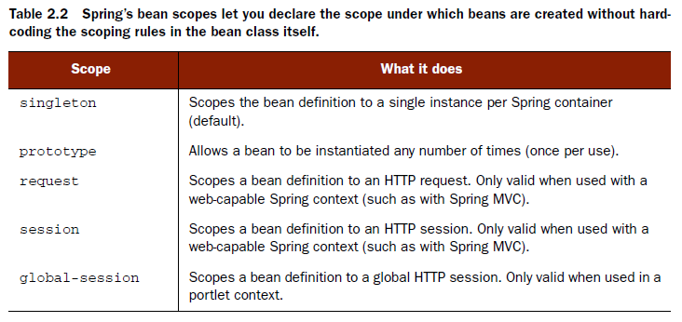
For the most part, you’ll probably want to leave scoping to the default singleton, but prototype scope may be useful in situations where you want to use Spring as a factory for new instances of domain objects.

Slide 22
Spring’s notion of singletons is limited to the scope of the Spring context. Unlike true singletons, which guarantee only a single instance of a class per classloader
Demo Singleton vs. Prototype Tickets
Notes:
nothing is stopping you from instantiating that same class in a more conventional way or even defining several <bean> declarations that instantiate the same class.

Slide 23
2.1.5 Initializing and destroying beans
When a bean is instantiated, it may be necessary to perform some initialization to get it into a usable state
Likewise, when the bean is no longer needed and is removed from the container, some cleanup may be in order
To accommodate setup and teardown of beans, Spring provides hooks into the bean lifecycle.

Slide 24
To define setup and teardown for a bean, simply declare the <bean> with init- method and/or destroy-method parameters.
The init-method attribute specifies a method that is to be called on the bean immediately upon instantiation
Similarly, destroy-method specifies a method that is called just before a bean is removed from the container

Slide 25
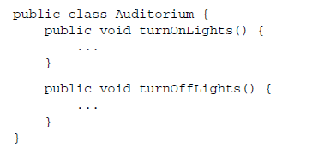

Demo init-method and destory-method

Slide 26
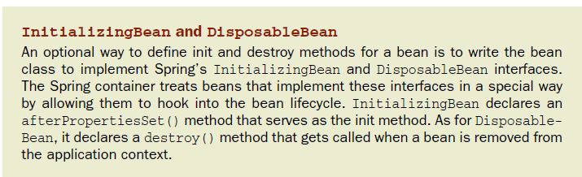
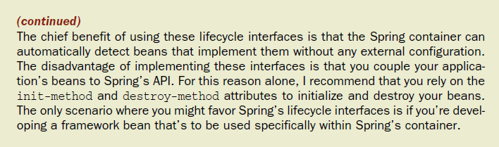

Slide 27
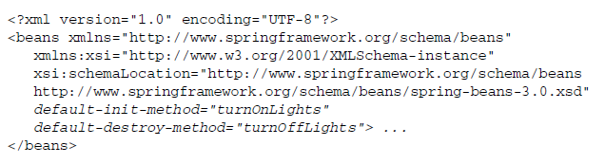
DEFAULTING INIT-METHOD AND DESTROY-METHOD
Notes:
-try this out

Slide 28
2.2 Injecting into bean properties
Spring can take advantage of a property’s setter method to configure the property’s value through setter injection.
To demonstrate Spring’s other form of DI, let’s welcome our next performer to the stage -Kenny

Slide 29
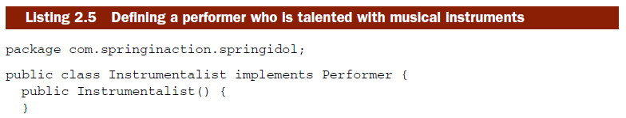
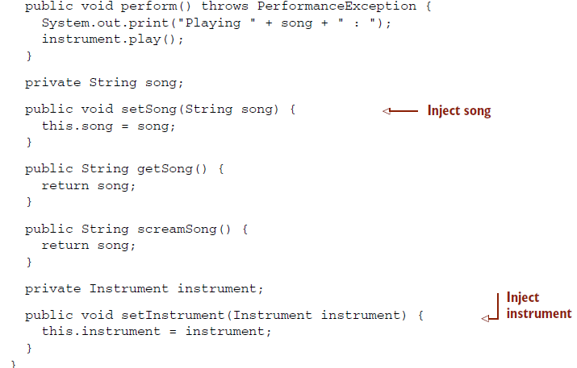
Notes:
2 properties: song and instrument

Slide 30
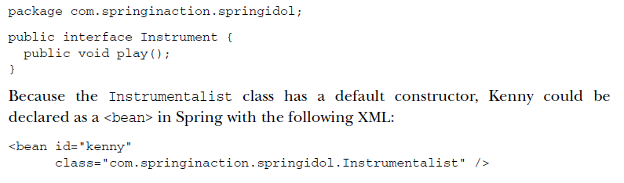
Notes:
Although Spring will have no problem instantiating kenny as an Instrumentalist, Kenny will have a hard time performing without a song or an instrument. Let’s look at how to give Kenny his song and instrument by using setter injection.

Slide 31
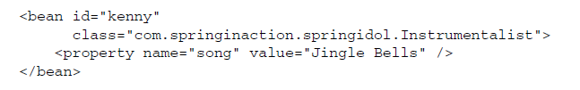
2.2.1 Injecting simple values
Bean properties can be configured in Spring using the <property> element. <property> is similar to <constructor-arg> in many ways, except that instead of injecting values through a constructor argument, <property> injects by calling a property’s setter method

Slide 32
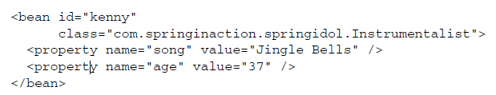
The <property> element in the XML instructs Spring to call setSong() to set a value of "Jingle Bells" for the song property.
The value attribute can also specify numeric (int, float, java.lang.Double, and so on) values as well as boolean values.
Notes:
Since the age property is an int, Spring knows to con- vert 37 to an int value before calling setAge().
-Using <property> to configure simple properties of a bean is great, but there’s more to DI than just wiring hardcoded values. The real value of DI is found in wiring an application’s collaborating objects together so that they don’t have to wire themselves together. To that aim, let’s see how to give Kenny an instrument that he can play.

Slide 33
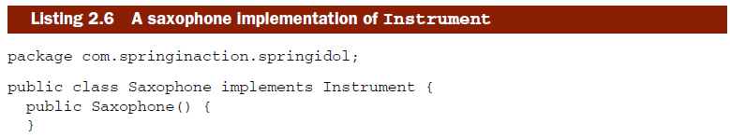

2.2.2 Referencing other beans
Kenny does have a favorite instrument. His instrument of choice is the saxo-phone.

Slide 34
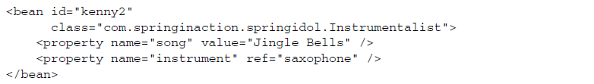
Now the kenny bean has been injected with all of its properties and Kenny is ready to perform.
Notes:
Before you can give Kenny a saxophone to play, you must declare it as a bean in the Spring container

Slide 35
Exercise 2-5
Configure your Spring application context to let Kenny to perform with his favorite song(“Jingle Bells”) and his favorite instrument(saxophone);

Slide 36
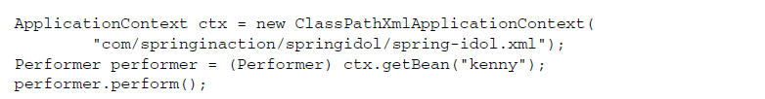
This isn’t a feature of Spring as much as it’s a benefit of coding to interfaces. By referring to a performer through the Performer interface, we can blindly cause any type of performer to perform, whether it’s a poetic juggler or a saxophonist. Spring encourages the use of interfaces for this reason. And, as you’re about to see, interfaces work hand in hand with DI to provide loose coupling.

Slide 37
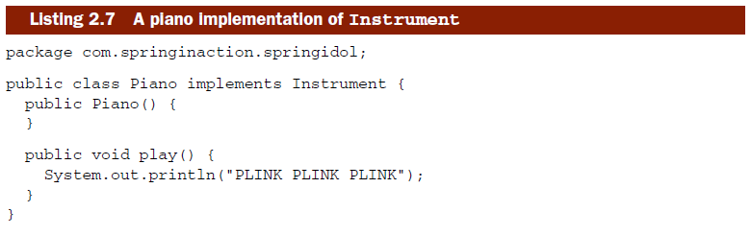
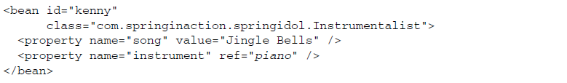
As mentioned, Kenny can play virtually any instrument that’s given to him as long as it implements the Instrument interface.

Slide 38
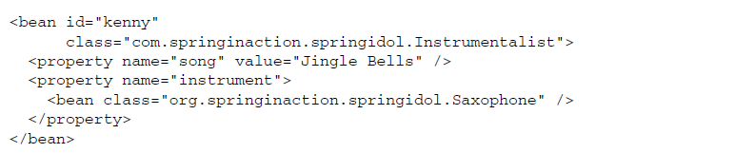
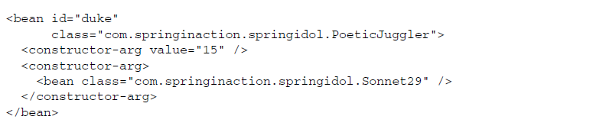
INJECTING INNER BEANS
Kenny is concerned about the sharing of his instruments
To help Kenny avoid germs, we’ll use a handy Spring technique known as inner beans.
Notes:
-Note that the inner beans don’t have an id attribute set. Though it’s perfectly legal to declare an ID for an inner bean, it’s not necessary because you’ll never refer to the inner bean by name.
-You may also find that using inner-bean definitions has a negative impact on the readability of the XML in the Spring context files

Slide 39
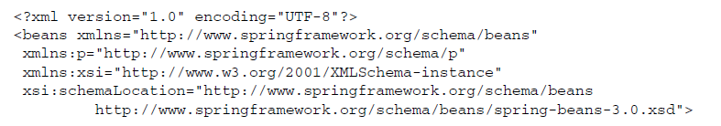
2.2.3 Wiring properties with Spring’s p namespace
Spring’s p namespace offers a way to wire bean properties that doesn’t require so many angle brackets.

Slide 40

The choice between <property> and the p namespace is up to you. They work equally well. The primary benefit of the p namespace is that it’s more terse
Kenny’s limitation: he can play only one instrument at a time. Next to take the stage in the Spring Idol competition is Hank, a performer who can simultaneously play multiple instruments.
Notes:
The -ref suffix serves as a clue to Spring that a reference should be wired instead of a literal value.

Slide 41
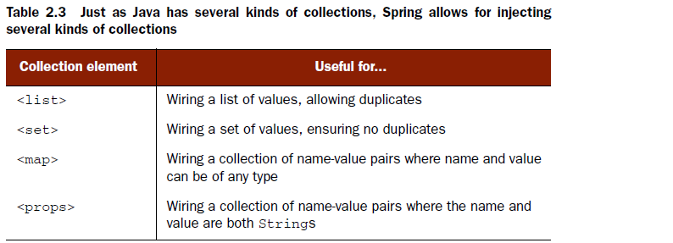
2.2.4 Wiring collections
How can Spring help you when your bean has properties that are plural—what if a property is a collection of values?

Slide 42
The <list> and <set> elements are useful when configuring properties that are either arrays or some implementation of java.util.Collection.
As for <map> and <props>, these two elements correspond to collections that are java.util.Map and java.util.Properties, respectively
Please welcome Hank to the Spring Idol stage. Hank’s special talent is that he’s a one-man band.
Notes:
As you’ll soon see, the actual implementation of the collection used to define the property has little correlation to the choice of <list> or <set>.

Slide 43
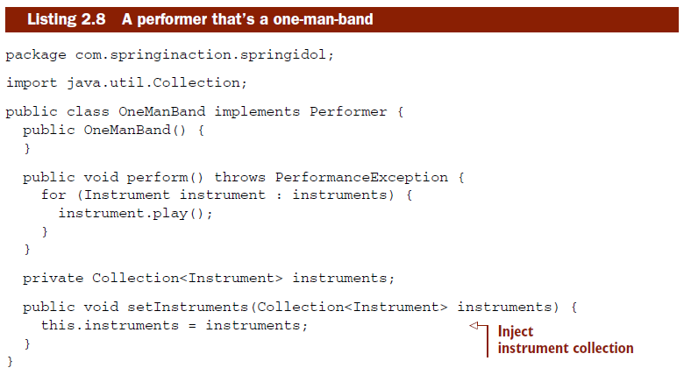

Slide 44
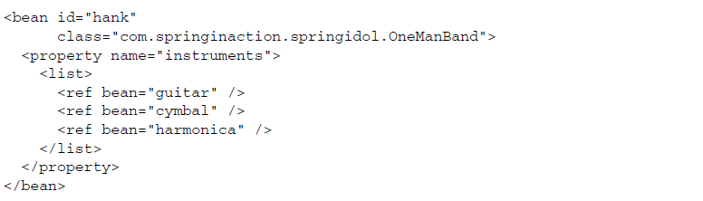
WIRING LISTS, SETS, AND ARRAYS
The <list> element contains one or more values.
Here <ref> elements are used to define the values as references to other beans in the Spring context, configuring Hank to play a guitar, cymbal, and harmonica.

Slide 45
It’s also possible to use other value-setting Spring elements as the members of a <list>, including <value>, <bean>, and <null/>. In fact, a <list> may contain another <list> as a member for multidimensional lists.
The <list> element we just used would still work, even if the instruments property were to be declared as java.util.List<Instrument>instruments; or even if it were to be declared as Instrument[]instruments;

Slide 46
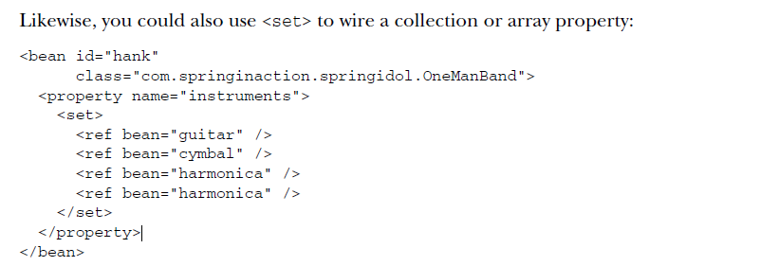
Just because a property is a java.util.Set, that doesn’t mean that you must use <set> to do the wiring
Exercise 2-6
Let Hank(com.springinaction.springidol.OneManBand) perform
Notes:
-Again, either <list> or <set> can be used to wire any implementation of java.util.Collection or an array. Just because a property is a java.util.Set, that doesn’t mean that you must use <set> to do the wiring. Even though it may seem odd to configure a java.util.List property using <set>, it’s certainly possible. In doing so, you’ll be guaranteed that all members of the List will be unique.
-

Slide 47
WIRING MAP COLLECTIONS
When a OneManBand performs, each instrument’s sound is printed as the perform() method iterates over the collection of instruments. But suppose that you also want to see which instrument is producing each sound.

Slide 48
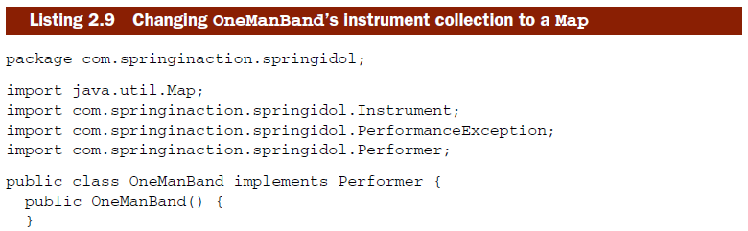
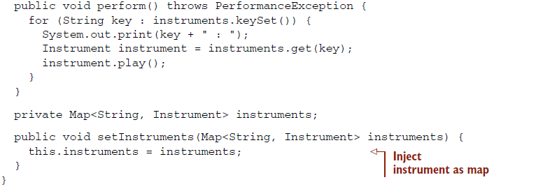

Slide 49
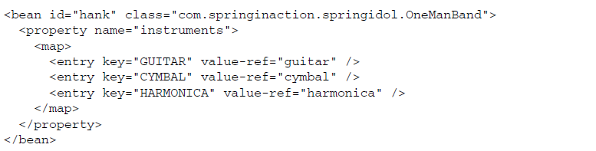
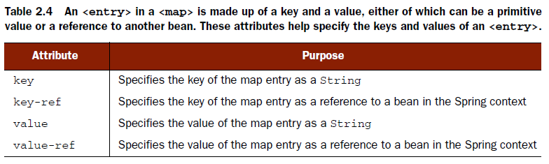

Slide 50
Exercise 2-7
Declare another bean ‘hank2’ using com.springinaction.springidol2.OneManBand
Let hank2 perform
<map> is only one way to inject key-value pairs into bean properties when either of the objects isn’t a String. Let’s see how to use Spring’s <props> element to configure String-to-String mappings.

Slide 51

WIRING PROPERTIES COLLECTIONS
if you find yourself configuring a Map whose entries have both String keys and String values, you may want to consider using java.util.Properties instead of a Map.

Slide 52
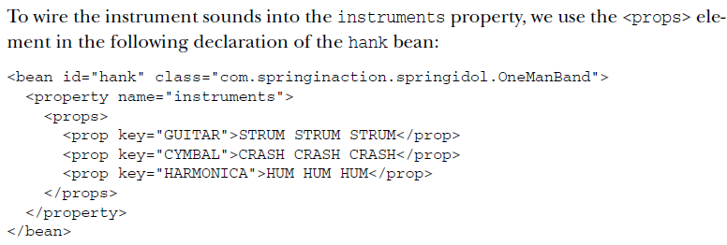
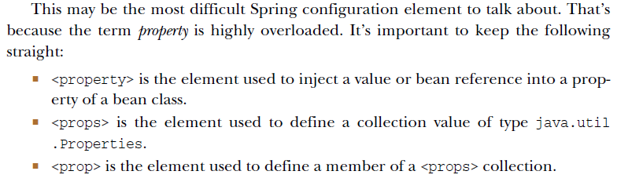

Slide 53
2.2.5 Wiring nothing (null)
You read that right. In addition to all of the other things Spring can wire into a bean property or constructor argument, it can also wire nothing- null
Why would I ever want to wire null into a property? Aren’t all properties null until they’re set? What’s the point?”

Slide 54
What if, for some twisted reason, you want to force that property to be null? If that’s the case, it’s not sufficient to just assume that the property will be null—you must explicitly wire null into the property.
Another reason for explicitly wiring null into a property is to override an autowired property value.

Slide 55
2.3 Wiring with expressions
What if we want to wire properties with values that aren’t known until runtime?
Spring 3 introduced the Spring Expression Language (SpEL), a powerful yet succinct way of wiring values into a bean’s properties or constructor arguments using expressions that are evaluated at runtime.
Notes:
When we wired the name of a song into the Instrumentalist bean, that value was determined at development time. And when we wired references to other beans, those references were also statically determined while we wrote the Spring configuration.

Slide 56
SpEL has a lot of tricks up its sleeves, including
The ability to reference beans by their ID
Invoking methods and accessing properties on objects
Mathematical, relational, and logical operations on values
Regular expression matching
Collection manipulation
Writing a SpEL expression involves piecing together the various elements of the SpEL syntax.

Slide 57
2.3.1 Expressing SpEL fundamentals
The ultimate goal of a SpEL expression is to arrive at some value after evaluation.
The simplest kinds of values that SpEL can evaluate may be literal values, references to a bean’s properties, or perhaps a constant on some class.

Slide 58
LITERAL VALUES
The simplest possible SpEL expression is one that contains only a literal value.
For example, the following is a perfectly valid SpEL expression:
5
The #{} markers are a clue to Spring that the content that they contain is a SpEL expression. They could be mixed with non-SpEL values as well:

Slide 59
Floating-point numbers can also be expressed in SpEL. For example:
Numbers can even be expressed in scientific notation. As an example, the following snippet of code sets a capacity property to 10000.0 using scientific notation:
Literal String values can also be expressed in SpEL with either single or double quote marks.

Slide 60
Or if you were using single quote marks for XML attribute values, then you’d want to use double quotes in the SpEL expression:
A couple of other literal values you may use are the Boolean true and false values.
We’ll eventually need them as our expressions get more complex

Slide 61
REFERENCING BEANS, PROPERTIES, AND METHODS
Another basic thing that a SpEL expression can do is to reference another bean by its ID.
Same as this?
Let’s say that you want to configure a new Instrumentalist bean whose ID is carl. The funny thing about Carl is that he’s a copycat performer. Instead of performing his own song, he’s going to be wired to perform whatever song Kenny plays.

Slide 62
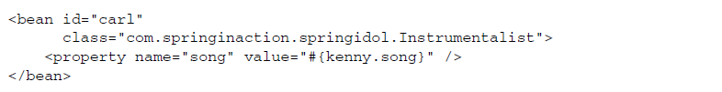
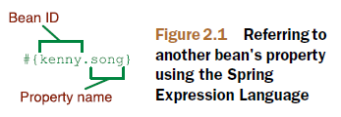
By wiring the carl bean’s song property this way, it’s effectively as if you programmatically performed the following Java code:

Slide 63
Referencing a bean’s properties isn’t the only thing you can do with a bean. You could also invoke a method.
Now suppose that (for whatever reason), Carl wants the song given to him in all uppercase.
Worried of NPEs?
Notes:
-The way to avoid the dreaded NullPointerException in SpEL is to use the null-safe accessor
-Instead of a lonely dot (.) to access the toUpperCase() method, now you’re using ?. operator. This operator makes sure that the item to its left isn’t null before accessing the thing to its right.
-how about calling a static method or a CONSTANT

Slide 64
WORKING WITH TYPES
The key to working with class-scoped methods and constants in SpEL is to use the T() operator.
For example, to express Java’s Math class in SpEL, you’d need to use the T() operator like this:
Notes:
-Now that we’ve added a few of the most basic SpEL expressions to our bag of tricks, let’s step things up a bit by looking at the types of operations we can perform on those simpler expressions.

Slide 65
Exercise 2-8
Create a ‘carl’ bean of type com.springinaction.springidol.Instrumentalist copying kenny’s song. Let him perform.

Slide 66
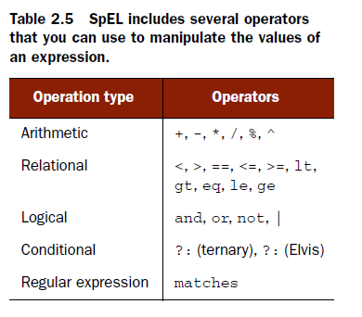
2.3.2 Performing operations on SpEL values

Slide 67
DOING MATH WITH SPEL

Slide 68
Unlike Java, SpEL also offers a power-of operator in the form of the carat:
Even though we’re talking about SpEL’s arithmetic operators, it’s worth mentioning that the + operator is overloaded to perform concatenation on String values.

Slide 69
COMPARING VALUES
SpEL offers all of the expected comparison operators that Java itself also offers.
Unfortunately, the less-than and greater-than symbols pose a problem when using these expressions in Spring’s XML configuration

Slide 70
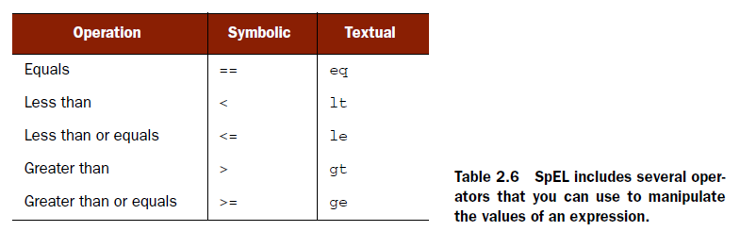

Slide 71
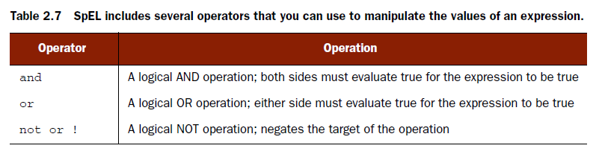
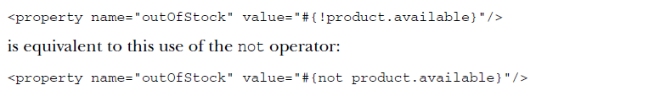
LOGICAL EXPRESSIONS

Slide 72
CONDITIONALLY EVALUATING
As you can see, SpEL’s ternary operator works the same as Java’s ternary operator. In this case, the instrument property will be wired with a reference to the piano bean if the song selected is “Jingle Bells.” Otherwise, it’ll be wired with the bean whose ID is saxophone.
Notes:
Although that’ll work, there’s a bit of duplication in that we refer to kenny.song twice.

Slide 73
Variant of ternary operator:
When used this way, ?: is referred to as the Elvis operator.

Slide 74
REGULAR EXPRESSIONS IN SPEL
SpEL supports pattern matching in expressions with its matches operator.
The matches operator attempts to apply a regular expression (given as its right-side argument) against a String value (given as the left-side argument).
Notes:
-Now that we’ve seen how to evaluate expressions concerning simple values, let’s look at the kind of magic that SpEL can perform on collections.

Slide 75

2.3.3 Sifting through collections in SpEL
For demonstration purposes, suppose that you have a City class that’s defined as follows :
And, let’s suppose that you’ve configured a list of City objects in Spring by using the <util:list> element as shown next.

Slide 76
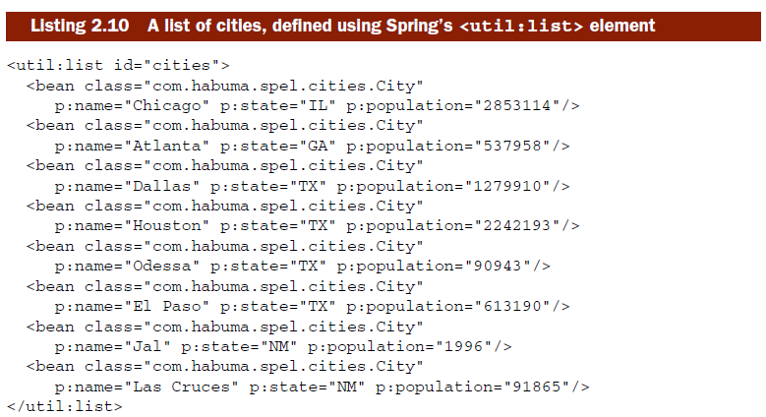
The <util:list> element comes from Spring’s util namespace. It effectively creates a bean of type java.util.List that contains all of the values or beans that it contains. In this case, that’s a list of eight City beans.

Slide 77
ACCESSING COLLECTION MEMBERS
In this case, I’ve selected the third city out of the zero-based cities list and wired it into the chosenCity property.
To spice up the example, we could randomly choose a city:
In any event, the square-braces ([]) operator serves to access a member of the collec- tion by its index.

Slide 78
The [] operator is also good for retrieving a member of a java.util.Map collection.
Another use of the [] operator is to retrieve a value from a java.util.Properties collection.

Slide 79
In addition to reading properties from a <util:properties>-declared collection, Spring makes two special selections of properties available to SpEL: systemEnvironment and systemProperties.
systemEnvironment contains all of the environment variables on the machine running the application.

Slide 80
Meanwhile, systemProperties contains all of the properties that were set in Java as the application started (typically using the -D argument).
Therefore, if the JVM were started with -Dapplication.home=/etc/myapp, then you could wire that value into the homePath property with the following SpEL incantation:

Slide 81
Although it doesn’t have much to do with working with collections, it’s worth noting that the [] operator can also be used on String values to retrieve a single character by its index within the String.
Notes:
-Accessing individual members of a collection is handy. But with SpEL, we can also select members of a collection that meet certain criteria. Let’s give collection selection a try.

Slide 82
SELECTING COLLECTION MEMBERS
Let’s say that you want to narrow the list of cities down to only those whose population is greater than 100,000.
it’s a simple matter of using a selection operator (.?[])

Slide 83
SpEL also offers two other selection operators, .^[] and .$[], for selecting the first and last matching items (respectively) from a collection.
For example, to select the first big city from cities:
What city will be assigned here?

Slide 84
PROJECTING COLLECTIONS
Collection projection involves collecting a particular property from each of the mem- bers of a collection into a new collection.
SpEL’s projection operator (.![]) can do exactly that.
For example, suppose that instead of a list of City objects, what you want is just a list of String objects containing the names of the cities. To get a list of just the city names, you could wire a cityNames property like this:

Slide 85
As a result of this expression, the cityNames property will be given a list of Strings, including values such as Chicago, Atlanta, Dallas, and so forth. The name property within the square braces decides what each member of the resulting list will contain.
But projection isn’t limited to projecting a single property. With a slight change to the previous example, you can get a list of city and state names:

Slide 86
Exercise 2-9
How will you wire a list of only big city names (population gt 100000)into the cityNames(name + state) property?

Slide 87
Since the outcome of the selection operation is a new list of City objects, there’s no reason why we can’t use projection on that new collection to get the names of all of the big cities.
This demonstrates that you can assemble simple SpEL expressions into more inter- esting (and more complex) expressions. It’s easy to see how that’s a powerful feature.

Slide 88
I encourage you to use SpEL wherever it can simplify what would otherwise be difficult (or even impossible) wirings. But be careful to not get too carried away with SpEL. Fight the temptation to put too much logic into a SpEL expression.

Slide 89
-End of Chapter 2-

